Slide 1
Toronto neighborhood demographics and the potential for restaurant growth
Robert Morris

Slide 2
Project summary
Combine Demographic data about the Neighborhoods of Toronto combined with Foursquare venue data to
Profile each neighborhood and
Allow users to study relevant demographic factors that determine whether a new restaurant will succeed in a given location.

Slide 3
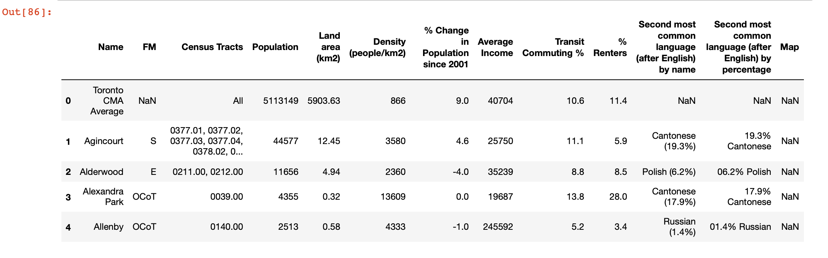
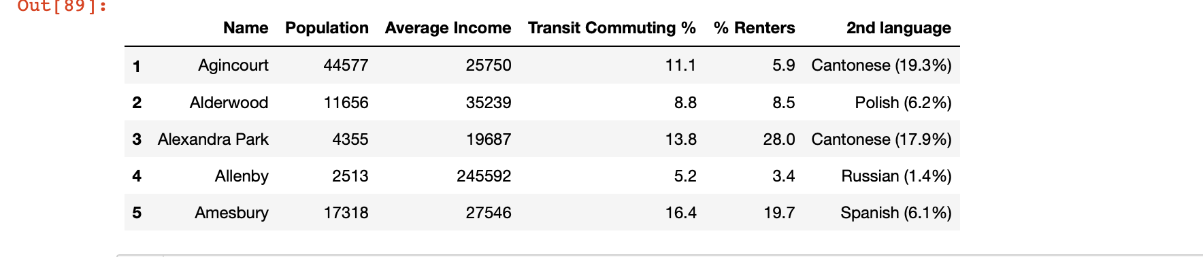
Pre processing demographic data
Before:
After: some useful information about the size and affluence of neighborhood.
Also, we keep the ethnic information.

Slide 4
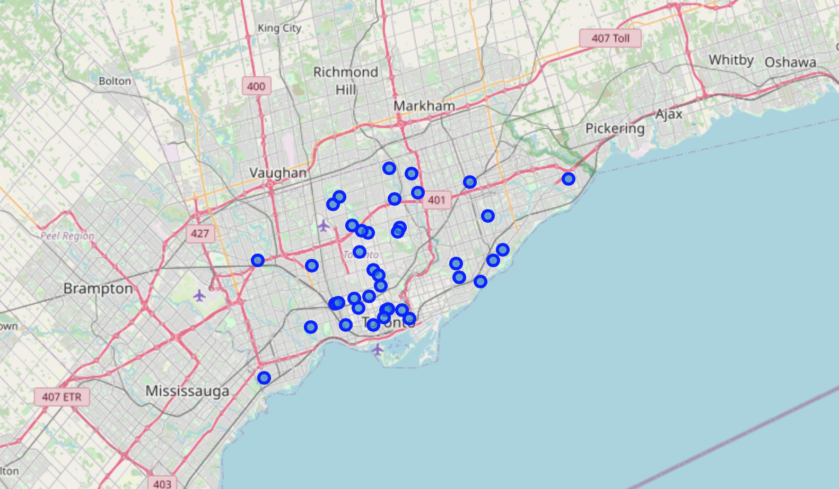
Map of Toronto neighborhoods using foursquare agent and Folium library

Slide 5
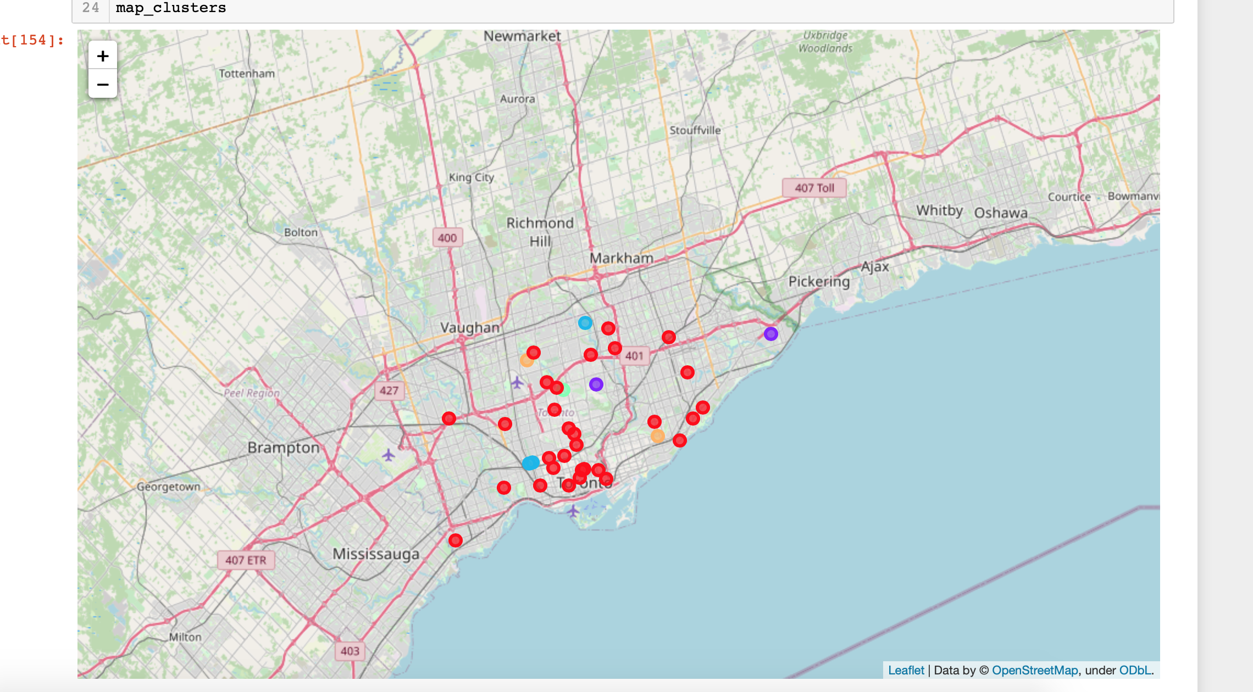
K-means clustering on venue data. The map identifying the clusters that results
Similar to the work done in class for New York, we generated 5 clusters based on the venue profiles using k-means. Here’s the resulting map of clusters.

Slide 6
Getting Neighborhood Venue data from Foursquare
Using the methods from class, we generated a data frame of all the venues of Toronto. Then we clustered them, counted them for each neighborhood, and generated a pie chart of
all the neighborhoods and the % of venues that appear in the neighborhood.

Slide 7
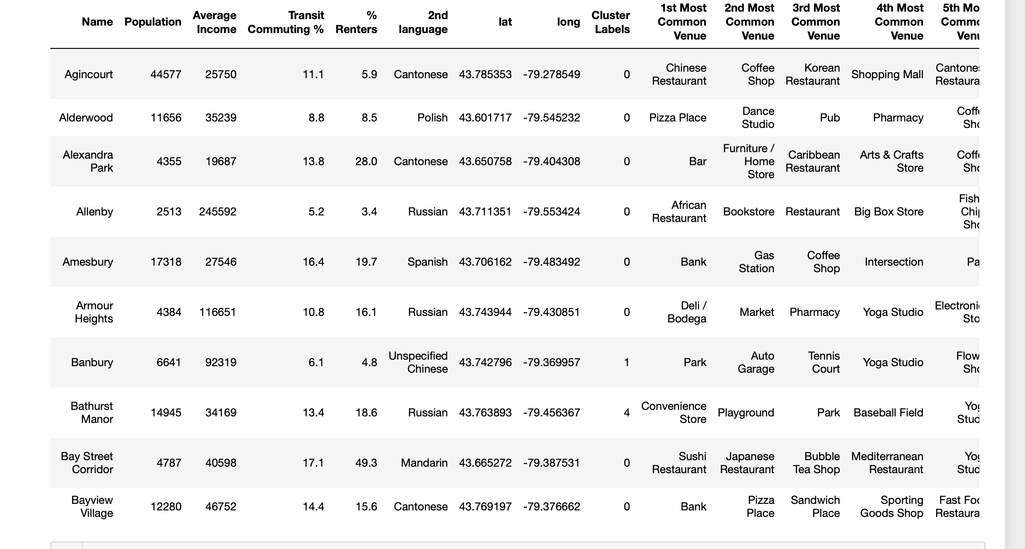
K-means Clustering of neighborhood venue profile
Again using the same methods we used in class for New York, we applied k-means cluster to try to identify neighborhoods with a similar venue profile. Here is the resulting dataframe.

Slide 8
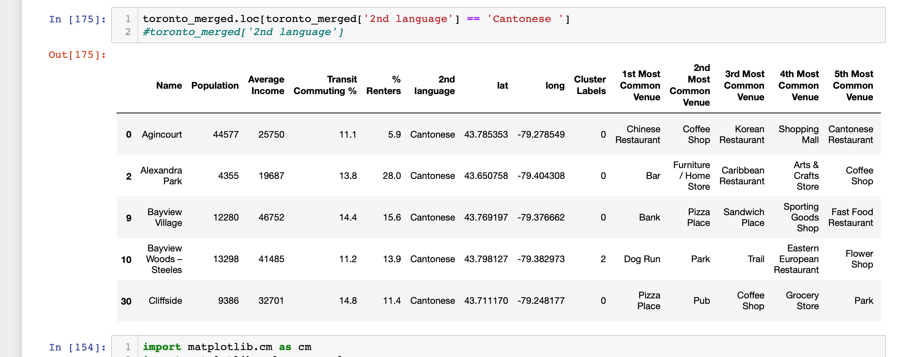
Applying the merged data: what neighborhoods might be able to support a new Cantonese restaurant?
Here are the neighborhoods that identify Cantonese as their second most spoken languages, taken from the demographic data, merged with the Foursquare venue data. From this query, one might conclude that neighborhoods other than Agincourt might be better suited to support a new Cantonese restaurant, because they don’t include Chinese restaurants in their list of most common venues.

Slide 9
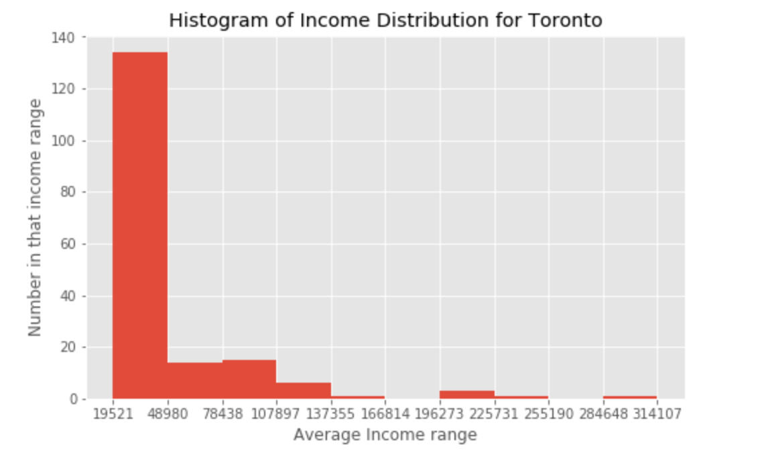
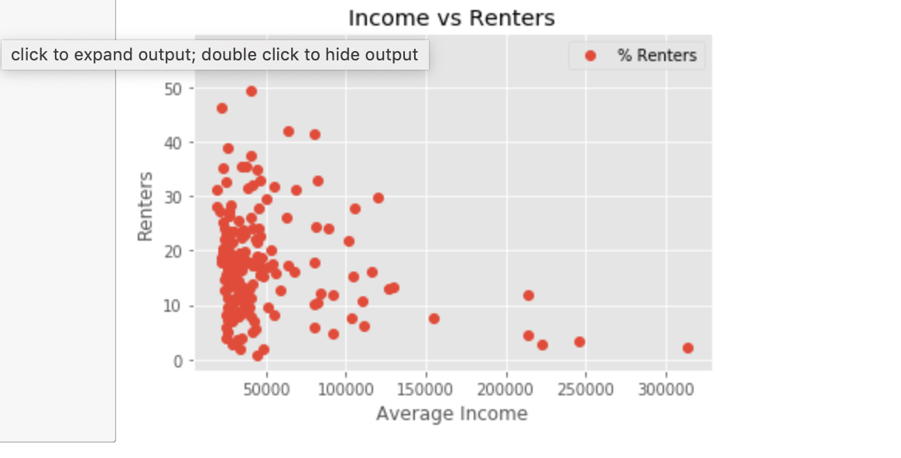
Statistics from the demographic data: histograms
Income Distribution
Correlating Income with whether a Toronto resident
rents.

Slide 10
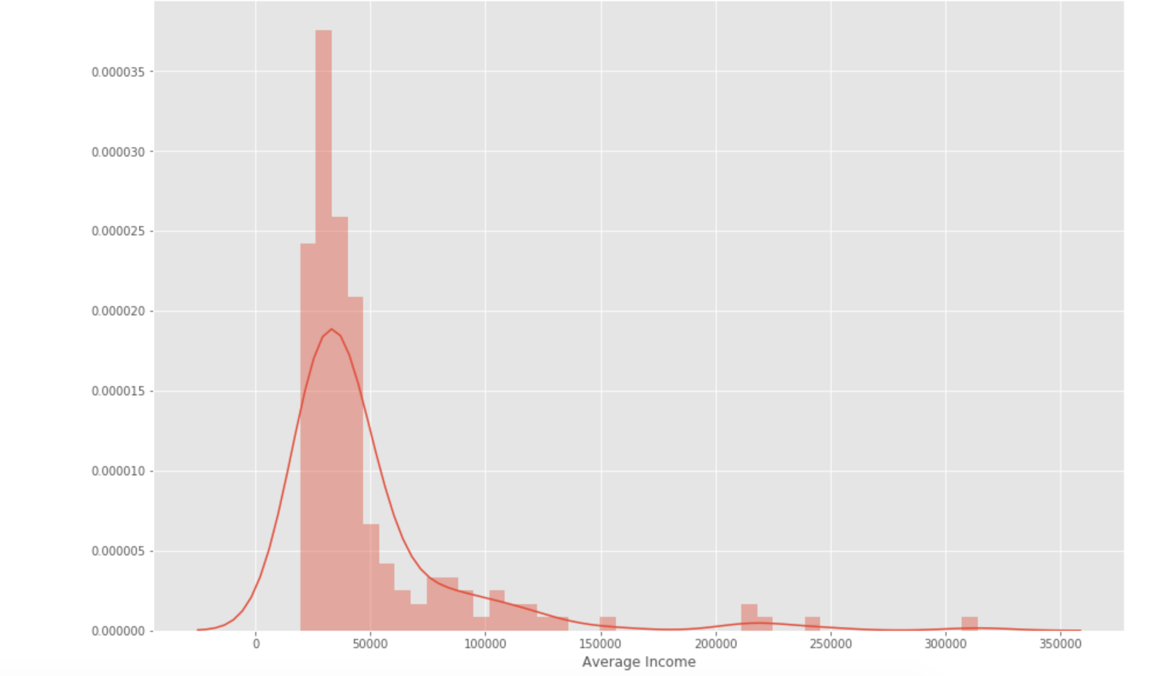
Income distribution: should I open an upscale restaurant in Toronto?
Using seabornInstance.distplot on average income to look at income distribution in Toronto.

Slide 11
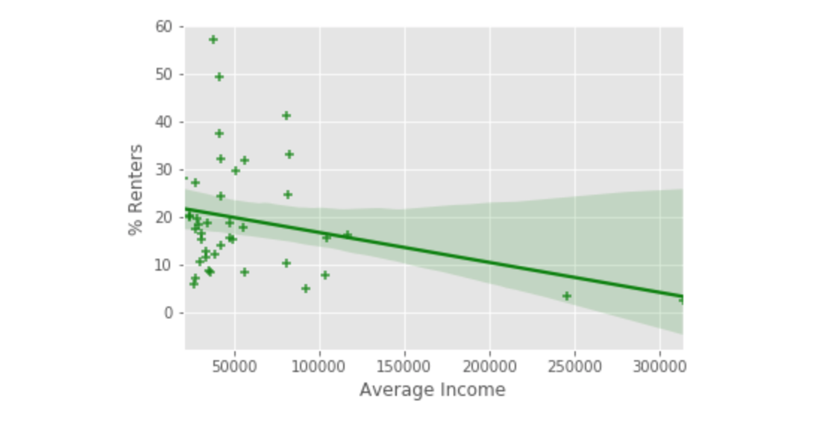
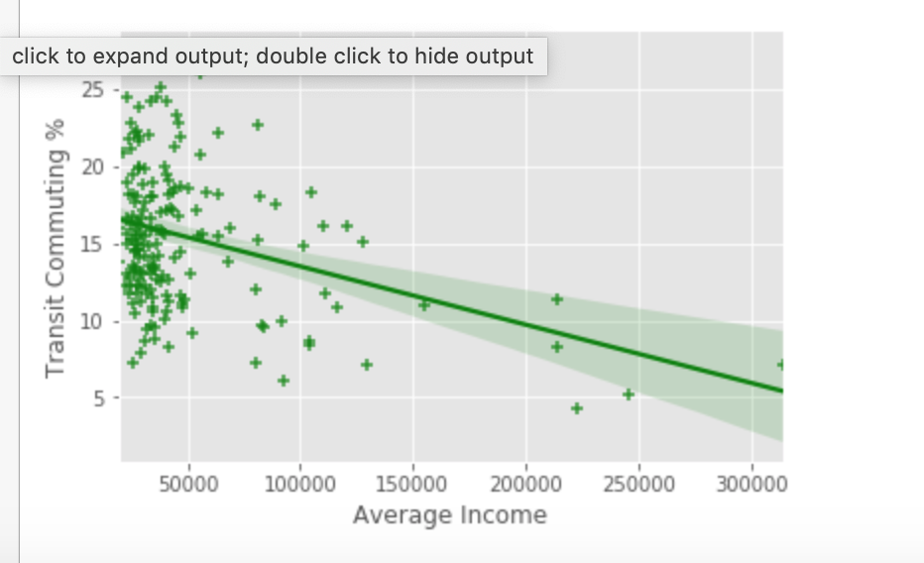
Linear regression models based on demographics
There’s a slight negative correlation between income and whether a Toronto resident rents.
There’s a slight negative correlation between income and whether a Toronto resident uses public transportation to get around.

Slide 12
Summary
Merging Toronto neighborhood demographic data with Foursquare venue data allows one to study how a neighborhood’s income and ethnic profile is related to the restaurants in the neighborhood.
Gaps between the ethnic profile and the list of venues might indicate whether a restaurant of a given ethnic type and price range can be supported by a neighborhood.
Much more work should be done to isolate the most important factors and build predictive models of Toronto neighborhoods.

